Slide 1
Forms of Presentation
Interpersonal Communication
(Characteristics, Elements, Types)

Slide 2
Unit 3 – Technical Presentation: Strategies & Techniques
Modes of Presentation – 4 methods of presentation delivery.
Strategies of Presentation – Audience, Locale, AV Aids, Kinesics, Paralinguistics, etc.
Forms/Methods of Presentation –
Interpersonal Communication –Characteristics, Elements, Types (Verbal & Non-verbal)
Classroom Presentation – Method/Types, Style and Tips
Individual Conferencing – Basic Introduction
Public Speaking –
Pattern- Deductive, Inductive, Causal, Q&A, etc.
Methods- Modes of delivery
Effective Public Speaking Techniques- Tips to make public speaking interesting.
Audience Participation and how to grasp audience interest
Use of humor, emotion, quizzes and interjection
Handling/Overcoming Stage Fear - Tips
Topics ‘A’ and ‘B’ to be studied from First Year notes.
Topics ‘C’, and ‘D’ to be studied from Second Year textbook and class notes.

Slide 3
Interpersonal Communication- Characteristics
Sharing information with two or more people.
Participants are in close proximity.
Many sensory channels are used.
Feedback is immediate.
Non-verbal communication plays an important role.

Slide 4
Interpersonal Communication- Elements
Sender
Message
Medium/Channel
Receiver
Feedback
Noise – It Refers to any interference faced while conveying the message (Barrier)
Context – Environment that influences the content of communication.

Slide 5
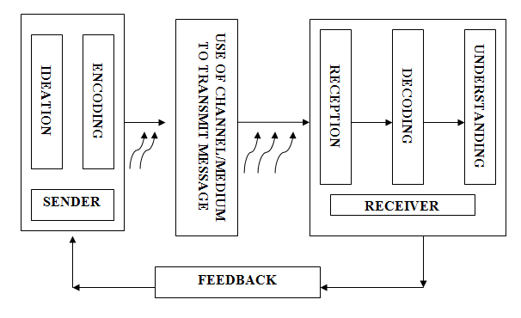
Process - Diagram

Slide 6
Types of Interpersonal Communication
On the basis of style –
Formal Communication
Informal Communication
On the basis of expression –
Verbal Communication
Non-verbal communication

Slide 7
Formal and Informal Communication
Criterion | Formal | Informal
Meaning | A type of verbal communication in which the interchange of information is done through the pre-defined channels is known as formal communication. | A type of verbal communication in which the interchange of information does not follow any channels i.e. the communication stretches in all directions.
Another Name | Official Communication | Grapevine communication
Reliability | More | Comparatively less
Speed | Slow | Very Fast
Evidence | As the communication is generally written, documentary evidence is present. | No documentary evidence.

Slide 8
Formal and Informal Communication….contd.
Criterion | Formal | Informal
Time Consuming | Yes | No
Advantage | Effective due to timely and systematic flow of information. | Efficient because employees can discuss work related problems, this saves time and cost of the organization.
Disadvantage | Distortion due to long chain of communication. | Spread of rumors
Secrecy | Full secrecy is maintained. | It is difficult to maintain the secrecy.
Flow of Information | Only through predefined channels. | Can move freely.

Slide 9
Verbal & Non-Verbal Communication
Criterion | Verbal | Non-Verbal
Definition | Verbal communication involves the use of words or speech or auditory language to express emotions or thoughts or exchange information. | Non-verbal communication involves the use of visual or non-verbal cues such as facial expressions, eye or body movements, gestures, and many more without speaking.
Communication Type | Formal as well as Informal | Informal
Impact of the Message | Very impactful as it is documented. | Very comprehensive as it shows the actual emotions of the person.
Communicates | Precise information. | Required information and at times more information.

Slide 10
Verbal & Non-Verbal Communication….contd.
Criterion | Verbal | Non-Verbal
Conveyed Through | Emails, letters, notes, reports, i.e. Anything in written and oral format where words are used. | Through Body posture, gestures, eye contacts, face expressions i.e. any form of expression.
Transparency Status | Clear and Concise. | Complex and sometimes confusing.
Spontaneity | Verbal communication is not that spontaneous. | Non-verbal communication comes spontaneously. Ex- we do not plan to cry when we are angry or blush when we are ashamed. It comes naturally.
Structure | It is very structured. | It is less structured and so its more difficult to study. No books on non-verbal communication can teach how to master the vocabulary of gestures, expression, etc.

Slide 11
Oral & Written Communication
Verbal communication is further divided into two types –
Oral communication
Written communication

Slide 12
Oral and Written Communication
Criterion | Oral | Written
Meaning | Exchange of ideas, information and message through spoken words is Oral Communication. | Interchange of message, opinions and information in written or printed form is Written Communication.
What is it? | Communication with the help of words of mouth. | Communication with the help of text.
Literacy | Not required at all. | Necessary for communication.
Transmission of message | Speedy | Slow
Proof | No record of communication is there. | Proper records of communication are present.

Slide 13
Oral and Written Communication….contd.
Criterion | Oral | Written
Feedback | Immediate feedback can be given | Feedback takes time.
Revision before delivering the message | Not possible | Possible
Receipt of nonverbal cues | Yes | No
Probability of misunderstanding | Very high | Quite less
Feedback | Immediate feedback can be given | Feedback takes time.

Slide 14
THANKS

